Slide 1
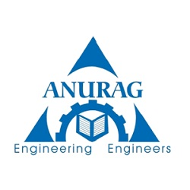
DESIGN OF CURRENT MIRROR BASED TWO STAGE CMOS CASCODE OP-AMP FOR HIGH FREQUENCY APPLICATION
Team Members: Under the guidance of:
D.Rudra Pratap - 16H61A0441 Neetu Srivatsava-Associate Professor
M.Manoj Kumar - 16H61A0430
K.Pradeep Kumar - 16H61A0426

Slide 2
Contents:
Aim of the project(Abstract)
Important Key Terms
Block Diagram
Methodology
Circuit Explanation
Results(Expected Vs Acquired)
Applications
Conclusion

Slide 3
Aim of the project :
This project mainly focuses on a High slew rate, Moderate gain, Ultra wide band two stage CMOS cascode operational amplifier for “Radio Frequency” application.
Current mirror based cascoding technique is mainly used to increase the gain charecteristics of the circuit.
We are going to implement on 180nm technology.
This radio frequency integrated circuit (RFIC) is in high demand for VLSI
High frequency application requires High speed Op-Amp.
Unity gain bandwidth should be very high because our circutory is going to be applied for Wireless Application.

Slide 4
Important Keywords:
Current Mirror
Differential Op-Amp
Gain
Bandwidth
Slew Rate
Power consumption
Cascode Op-Amp

Slide 5
Block Diagram :
Non-Inverting Input
+
Input Stage
-
Intermediate Stage
Level Shifting
Output Stage
Output
Inverting Input
Dual-Input
balanced Output Differential Amplifier
Dual-Input Unbalanced Output Differential Amplifier
Emitter Follower with constant current source
Complementary Symmetry Push-Pull Amplifier

Slide 6
Methodology :
The design of an Op-Amp with high UGB and moderate DC gain is a challenging task for an Analog designer.
In many literatures it is mentioned that the design of Op-Amp with moderate DC gain and UGB at low supply voltages requires 3 or even more stages.
But this proposed circuit uses a 2 stage Op-Amp for achieving moderate DC gain and high UGB.
To improve the gain there are 3 methods
(1) Increase the number of stages.
(2) Increase the Transconductance and
(3) Increase the output resistance.

Slide 7
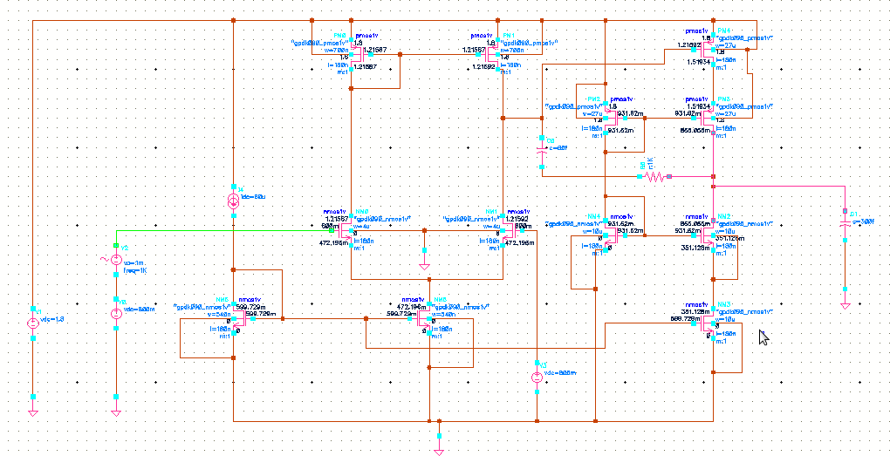
Proposed Circuit :

Slide 8
Current Mirror:
A current mirror is a circuit designed to copy a current through one active device by controlling the current in another active device of a circuit, keeping the output current constant regardless of loading.
The current mirror circuit copies current from a reference.
It finds application in analog circuits such as differential amplifiers, digital-to-analog (D/A) converters, etc.
A current mirror has very high internal resistance and can act as active current source.
Here, currents in the two transistors are mirrored, hence the name current mirror.

Slide 9
Differential Amplifiers :
Differential amplifiers are used to amplify analog as well as digital signals, and can be used in
various implementations to provide an output from the amplifier in response to differential inputs.
The differential amplifier is one of the most versatile circuits used in analog circuit design.
Why it is used?
Better common-mode noise rejection
Reduced harmonic distortion
Increased output voltage swing.

Slide 10
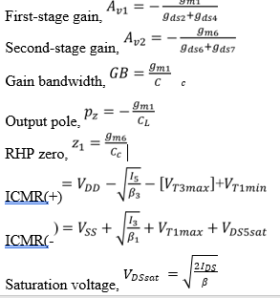
Two Stage op-amp Design Procedure

Slide 11
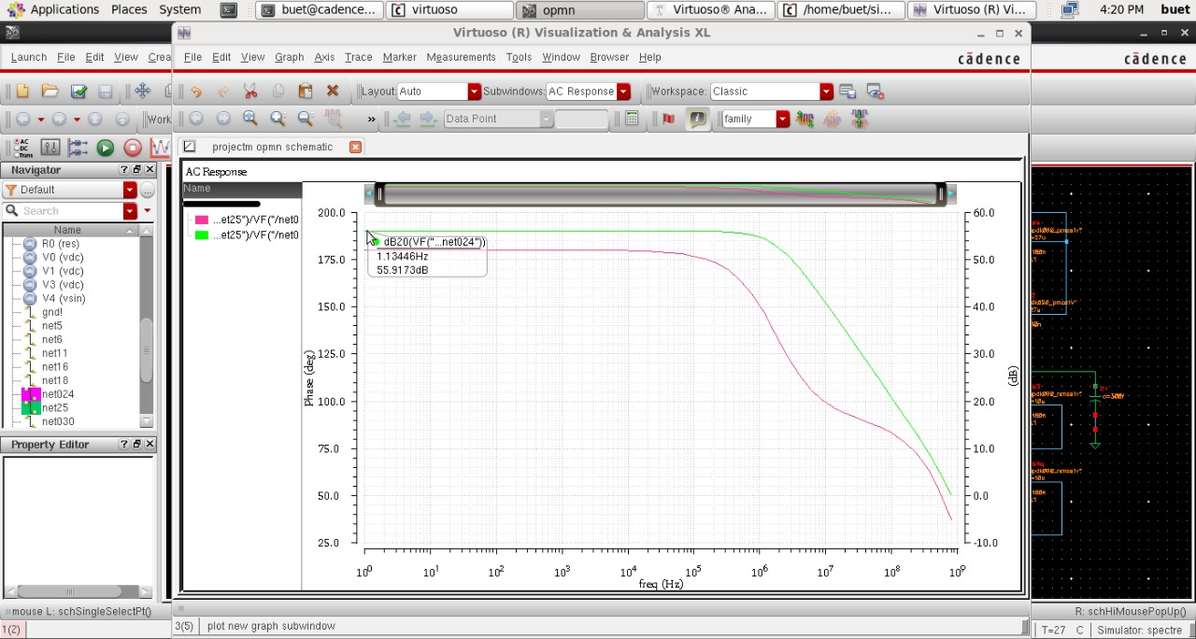
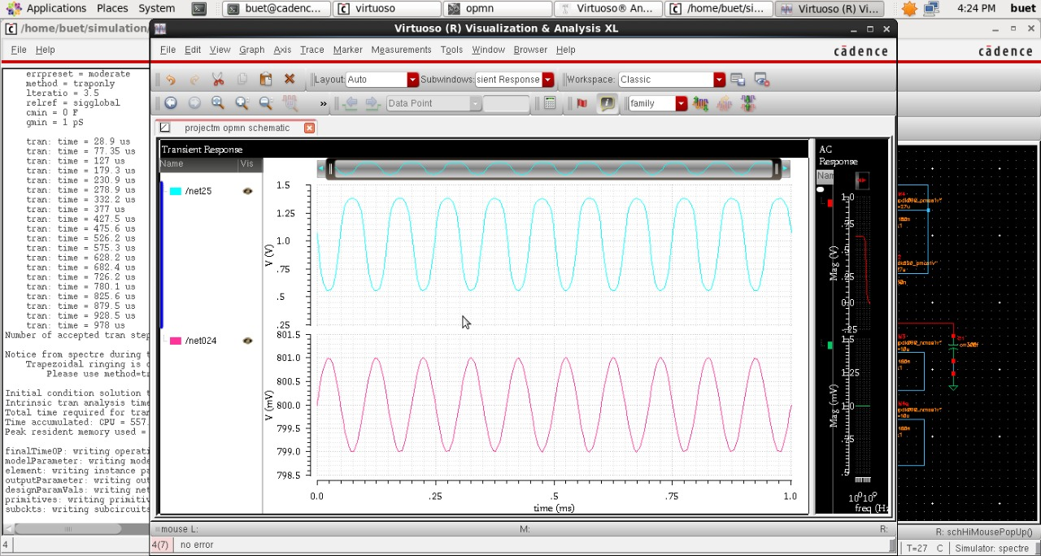
Results :
GAIN
PHASE
TRANSIENT ANALYSIS

Slide 12
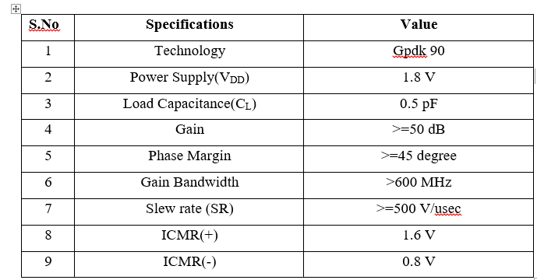
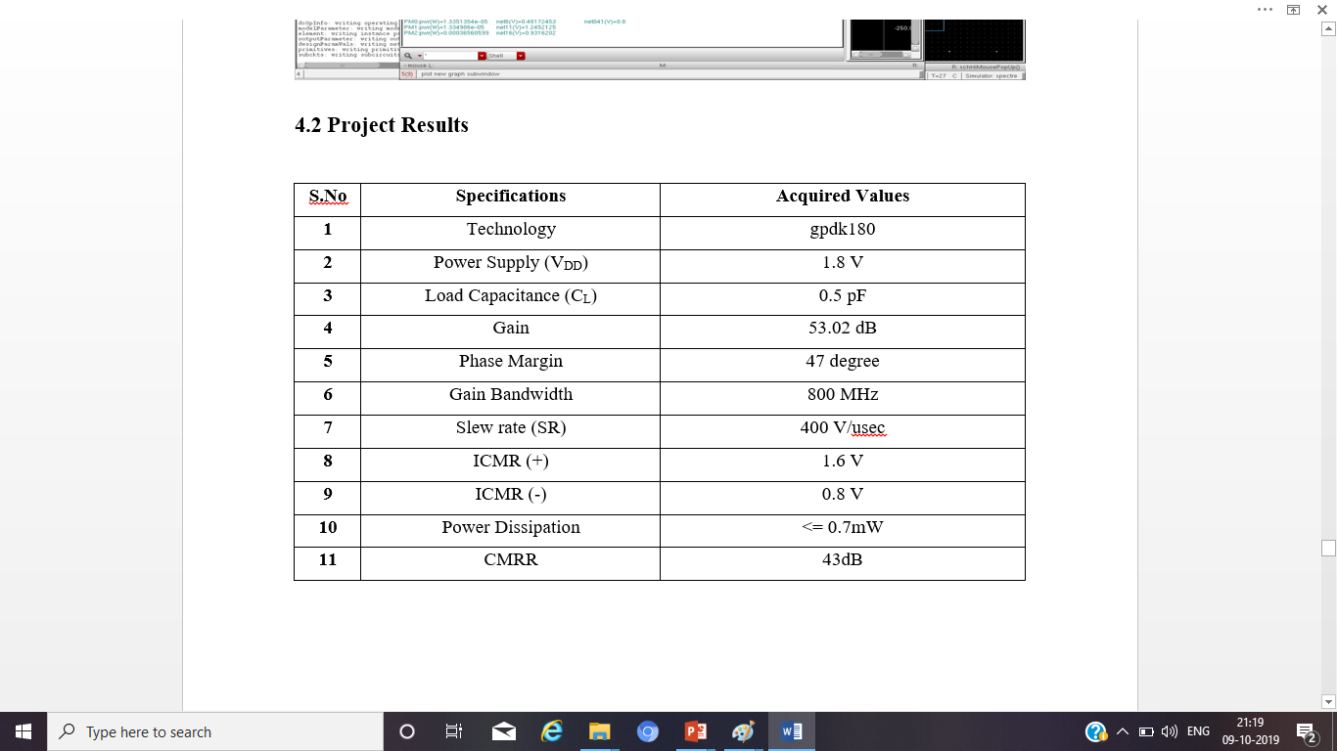
Comparision Between Theoritical & Practical Values :
THEORITICAL VALUES
PRACTICAL VALUES

Slide 13
Applications :
It is used in summer, subtractor circuits.
It is used in integrator, differentiator circuits.
It is used for various filter design like low pass, high pass, butterworth filters etc.
It is used in Instrumentation amplifiers.
It is used in voltage-to-current converter circuit.
Our cuircuit is mainly useful in high frequency wireless application.

Slide 14
CONCLUSIONS :
The main task of this project is to design the single stage and two stage CMOS operational amplifier using 180nm technology in Cadence Tools. Firstly we studied the basic characteristics of nMOS and pMOS transistors, their operating region.
We designed basic analog building blocks like MOSFET switch, MOSFET diode, and current mirror.
we designed CMOS amplifier and common source amplifier.
Finally, with the help of these building blocks we designed single stage and two stage CMOS operational amplifier.
The notable performance areas were the gain, gain bandwidth, slew rate, CMRR .

Slide 15
THANK YOU

